Slide 1
The English House
Your home of online learning.
By teacher Paul

Slide 2
Sloths: Lesson 2 Engineering

Slide 3
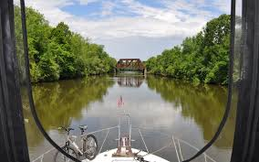
Erie Canal (US)

Slide 4
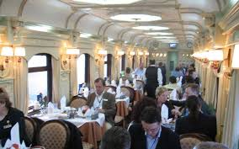
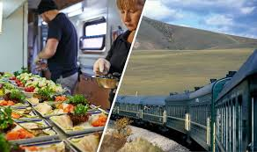
Trans-Siberian Railway

Slide 5
Hoover Dam (US)

Slide 6
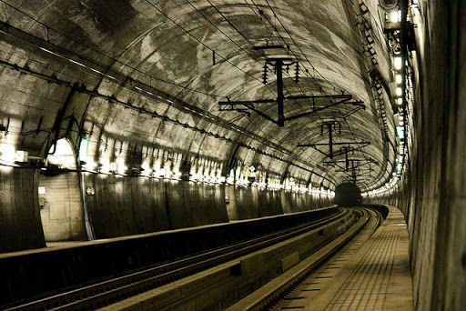
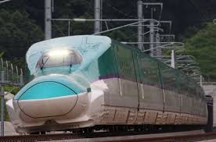
Seikan Tunnel (Japan)

Slide 7
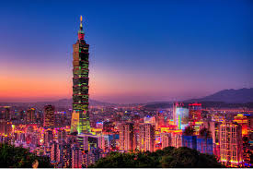
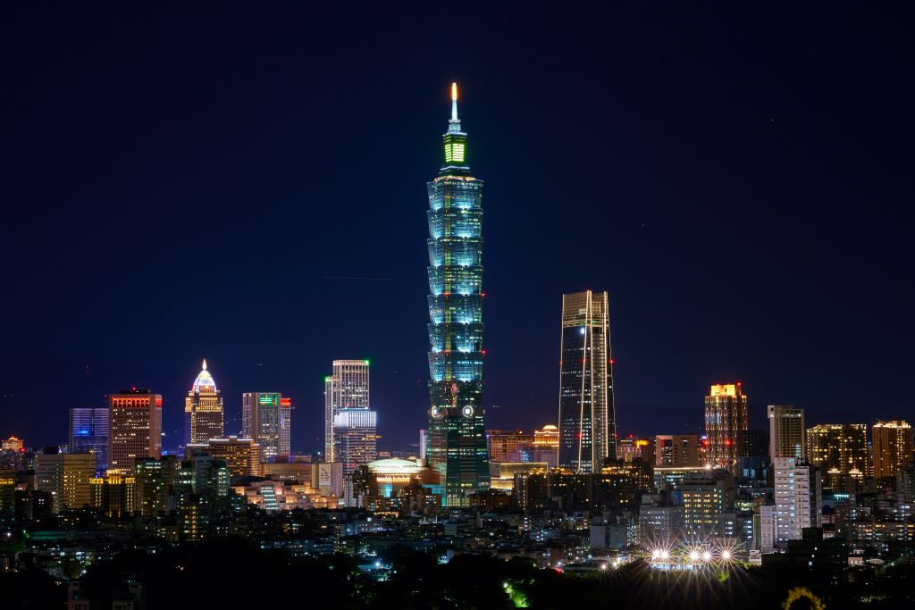
Taipei 101 Building (Taiwan)

Slide 8
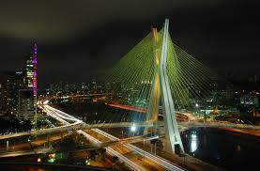
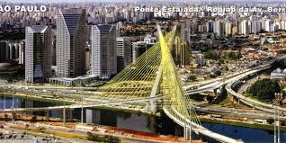
Oliviera Bridge (Brazil)

